Slide 1

THE NEW YORK STATE PROFESIONAL PROCESS SERVERS ASSOCIATION
18th ANNUAL CONVENTION
SUNDAY, NOVEMBER 5, 2023
KNIGHTS OF COLUMBUS
327 WESTCHESTER AVENUE
PORT CHESTER, NY 10573
914-939-4343
WELCOME BACK CONVENTION

Slide 2
NYSPPSA 2023 PROCESS SERVER CONVENTION AGENDA
SUNDAY, NOVEMBER 5, 2023
8:00am-9:00am Breakfast and Registration
9:00am-9:10am Opening Remarks
9:10am-9:15am Sponsorships
9:15am-9:30am Exhibitor Introductions
9:30am-11:00am Annual Board of Directors Meeting
11:00am-12:30pm Nominations and Elections
12:30pm-1:30pm LUNCH/Awards
1:30pm-4:00pm Larry Yellon Education Class (lower level)
1:30pm-2:30pm Speaker Thomas A. Mitchell Counsel, NYS Sheriff’s Association
2:30pm-4:00pm JEOPARDY
4:00pm-4:30pm Closing remarks/Q&A’s

Slide 3



WHERE TO STAY: BOOK ONLINE AT WWW.HOTELS.COM
Courtyard by Marriott – 631 Midland Ave, Rye NY 10580 914-921-1110
(0.9 miles from Port Chester, NY)
Hyatt House – 101 Corporate Park Drive, West Harrison, NY 10604 914-251-9700
(3.23 miles from Port Chester, NY)
Sonesta White Plains – 66 Hale Ave, White Plains, NY 10601 914-682-0050
(5.3 miles from Port Chester, NY)
Cambria Hotel – 250 Main Street, White Plains, NY 10601 914-681-0500
(5.56 miles from Port Chester, NY)
Residence Inn White Plains – 5 Barker Ave, White Plains, NY 10601 914-761-7700 (5.87 miles from Port Chester, NY)
Hyatt Regency – 1800 E Putnam Avenue Old Greenwich CT 06870 – 203-637-1234 (6.3 miles from Port Chester, NY)
- Westchester Marriott – 670 White Plains Road, Tarrytown, NY 10591 914-631-2200 (9.57 miles from Port Chester, NY)
TRANSPORTATION TO THE EVENT:
- The Knights of Columbus a short walk from the
Port Chester Train Station – Metro North - New Haven Line
- An hour ride from New York City by car

Slide 4

SATURDAY, NOVEMBER 4, 2023
We will be meeting on 11/4/23 at 6PM for cocktails.
LOCATION TO BE DETERMINED.

Slide 5
SWAG BAG
NYSPPSA will hold our 18th Annual Convention on Sunday, November 5, 2023 at The Knights of Columbus in Port Chester, NY. Swag Bags are loved by all and are a great way to market your business. All registered attendees will receive a swag bag. To include your company’s item in our swag bag, you can choose from the following:
- Be a sponsor and choose from one of the categories that would include your item with your logo.
- Bring your own item and include it in our swag bag for $20.00.
Want to be a promoter but can’t attend the convention, don’t miss the opportunity to be a Sponsor or Swag Bag promoter.

Slide 6





50/50 RAFFLE
SPEAKERS

Slide 7

BOARD OF DIRECTORS MEETING
SUNDAY, NOVEMBER 5, 2023

Slide 8
ROBERT MARCUS AWARD FOR PROFESSIONALISM & DISTINGUISHED SERVICE
The NYSPPSA Board unanimously voted to establish an award intended to recognize a member who has demonstrated professionalism and distinguished service to our association and the process serving profession. The award was named after Robert Marcus, a devoted member of NYSPPSA, who has since passed away. He had always embodied the spirit of the award. Past winners of this prestigious award are:
Irving Botwinick
Bob Gulinello
Vincent Gillis
Jillina A Kwiatkowski
Larry Yellon
Gail Kagan
Brenda Geedy
Kim Letus
Eric Vennes
Ellen Eakley
Fred Blum
BE THERE THIS YEAR FOR THE ANNOUNCEMENT OF THE
2023 RECIPIENT

Slide 9

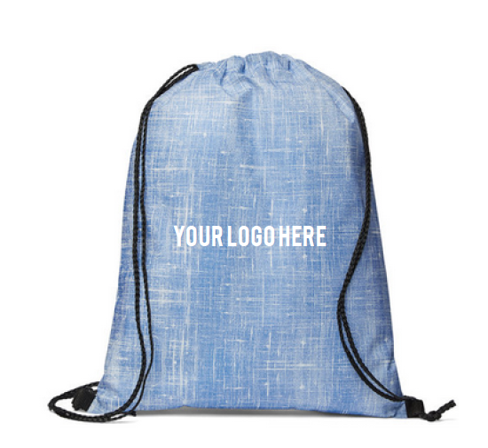
SPONSORSHIP PACKAGES AVAILABLE
WE MISSED YOU PACKAGE - $450 – 150 Bags
- Full Page Ad in the Convention Brochure
- Sponsor of the Swag Bag item with your Logo to be distributed to all
- Your Company Name on the Signage Registration Board
- Five minutes during the meeting to promote your company

Slide 10


SPONSORSHIP PACKAGES AVAILABLE
GLAD YOU ARE BACK PACKAGE: $375 – 250 Clips
- Full Page Ad in the Convention Brochure
- Sponsor of the Keep-It Bag Clip with your logo
- Sponsor of the Sunday Morning Breakfast
- Your Company Name on the Signage Registration Board

Slide 11


SPONSORSHIP PACKAGES AVAILABLE
Great to See You Package - $350 – 250 tapes
  - Half Page Ad in the Convention Brochure
- Sponsor of Transparent Tape-0-Matic with your logo
- Sponsor of the Sunday Luncheon
- Your Company Name on the Signage Registration Board

Slide 12


SPONSORSHIP PACKAGES AVAILABLE
NEW BEGINNINGS PACKAGE - $350 for 250 letter openers
- Half Page Ad in the Convention Brochure
- Sponsor of the Oval Letter Opener with your logo
- Your Company Name on the Signage Registration Board

Slide 13

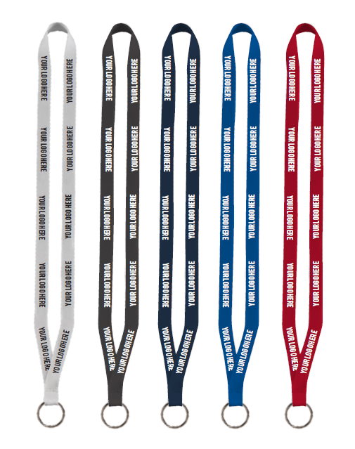
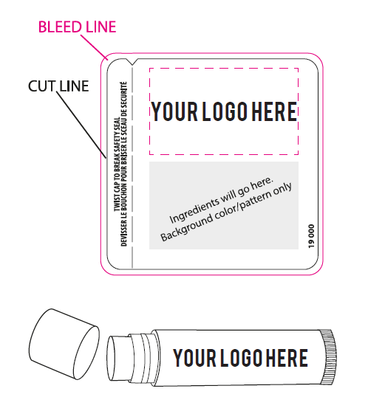
SPONSORSHIP PACKAGES AVAILABLE
STRONGER TOGETHER PACKAGE - $325 – 125 Lanyards
- Half Page Ad in the Convention Brochure
- Sponsor of the Lanyards for Name Tags with your logo
- Your Company Name on the Signage Registration Board
NYSPPSA STRONG PACKAGE - $275 – 250 Lip Balms
- Quarter Page Ad in the Convention Brochure
- Sponsor of the Lip Balm with your logo
- Your Company Name on the Signage Registration Board

Slide 14

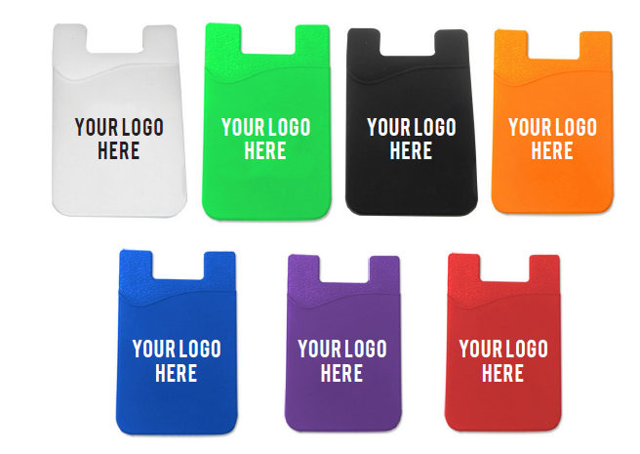

SPONSORSHIP PACKAGES AVAILABLE
TIME TO MAKE NEW MEMORIES PACKAGE - $250 - $125 Smartphone Wallets
- Quarter Page Ad in the Convention Brochure
- Sponsor of the Smartphone Wallet with your logo
- Your Company Name on the Signage Registration Board
TEAMWORK PACKAGE - $200 – 300 Slimster Pens
- Your Business Card Ad in the Convention Brochure
- Sponsor of the Slimster Pens with your logo
- Your Company Name on the Signage Registration Board
THE ADVENTURE CONTINUES PACKAGE: - $150
- Your Business Card Ad in the Convention Brochure
- Sponsor of the Table Centerpieces
- Your Company Name on the Signage Registration Board
GREAT TIME AHEAD PACKAGE - $150
- Your Business card in every swag bag
- Facebook postings for your company during the Convention
- Your Company Name on the Signage Registration Board

Slide 15

REGISTRATION FOR ATTENDANCE MUST BE COMPLETED ON
EVENTBRITE AT https://www.eventbrite.com/e/ny-state-professional-process-servers-association-18th-annual-convention-tickets-617163812577
REGISTRATION
  MEMBERSHIP REGISTRATION FOR ALL - $25.00
All Registrations include Breakfast & Lunch
Cash Bar at Lunch for drinks
“:
Cancellations Policy:
Any cancellations received within 7 days prior to the convention will receive a full refund. Any cancellations after that time will NOT.

